Slide 1
AI Therapist
TY-10
Aditya Patil (12)
Anuja Deshpande (56)
Surabhi Deshpande (57)
Dev Bohra (59)

Slide 2
Problem Statement
To create a system which will detect emotions from text inputed on how your day went/how you are currently feeling and give appropriate advice based on the emotions and also recommend songs as well as maintain log of emotions with timestamps.

Slide 3
Introduction
AI Therapist model utilizes LSTM networks and NLP techniques to deliver personalized mental health support. The model incorporates emotion detection, customized solutions, song recommendations, and emotion tracking capabilities. By analyzing natural language input, the AI Therapist accurately identifies users' expressed emotions and provides empathetic responses. Integration with the OpenAI API enhances the model's language capabilities, allowing for detailed explanations and practical guidance. The AI Therapist also tracks and logs users' emotions over time, enabling personalized interventions based on emotional patterns. Evaluation results demonstrate the effectiveness of the AI Therapist in providing meaningful mental health support. This comprehensive approach to mental healthcare empowers individuals to improve their emotional well-being.

Slide 4
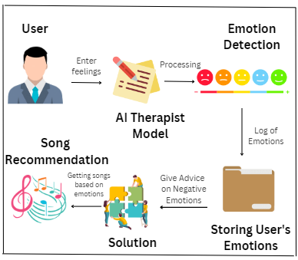
System
Work Flow

Slide 5
Tools and Technologies
1)Programming Language:
Python
2) Algorithms:
Bidirectional LSTM
GLoVe
3) OpenAI API

Slide 6
Thank You

